Slide 1



THE AQUANTIS OCEAN-CURRENT TURBINE
RENEWABLE ENERGY FROM MARINE CURRENTS
Blade Count Trade Study Update
11/29/2012
Ole Kils
Aquantis Inc.
Company Confidential and Proprietary

Slide 2
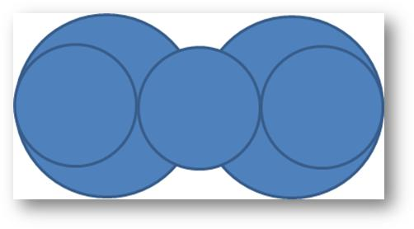
Idealized Hydrodynamic Model
  Basic hydrodynamic assumptions of 2- and 3-bladed rotors:
  Equal TSR
  Equal rotor diameter
  Equal solidity
  Equal thickness distribution (thickness as % chord)
  Equal rated power
  Equal torque
  This is assumed to give the following blade properties for a three-blade rotor vs. a two-blade-rotor:
  2/3 sectional chord along with equal thickness = 2/3 thickness
  2/3 sectional loading along with equal diameter = 2/3 sectional moment
  Volume ratio of this type of 2-bladed rotor is 1.5 times the three-bladed rotor

Slide 3
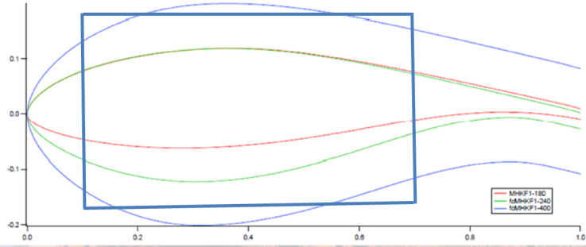

Idealized Parametric Structural Model
Idealize blade section as simple sandwich beam
  UD spars as facings
  Syntactic foam as core
Assume relationship between airfoil and ideal beam
  Beam height ~ .85 AF thickness
  Beam width ~ .6 AF chord
Approximate loading/sizing relevant to 2-bladed rotor configuration
  At ~10m span, ~2.35m chord.
  Assume baseline of 25% thick airfoil at 10m span.
  Assume 1m segment length for weight/displacement estimates.
  My at 10m span ~5450 kN-m.
Apply hydrodynamic scaling factors with constant solidity assumption for 3 bladed configuration
  2/3 chord with equal t/c yields 2/3 thickness.
  2/3 pressure yields 2/3 moment.
Assume other relevant material properties
  Modulus of UD glass and foam.
  Densities of UD glass, foam and saltwater
  Maximum allowable stress of UD glass (based on ARL strain limit).

Slide 4
Calculation approach
Two variables were investigated:
  % thickness at given chord and moment vs. rotor section wet weight and spar thickness.
  Loading intensity at given 35% t/c vs. rotor section wet weight and spar thickness.
Each configuration sets geometric or loading parameters and solves for spar cap thickness at design stress in the spars.

Slide 5
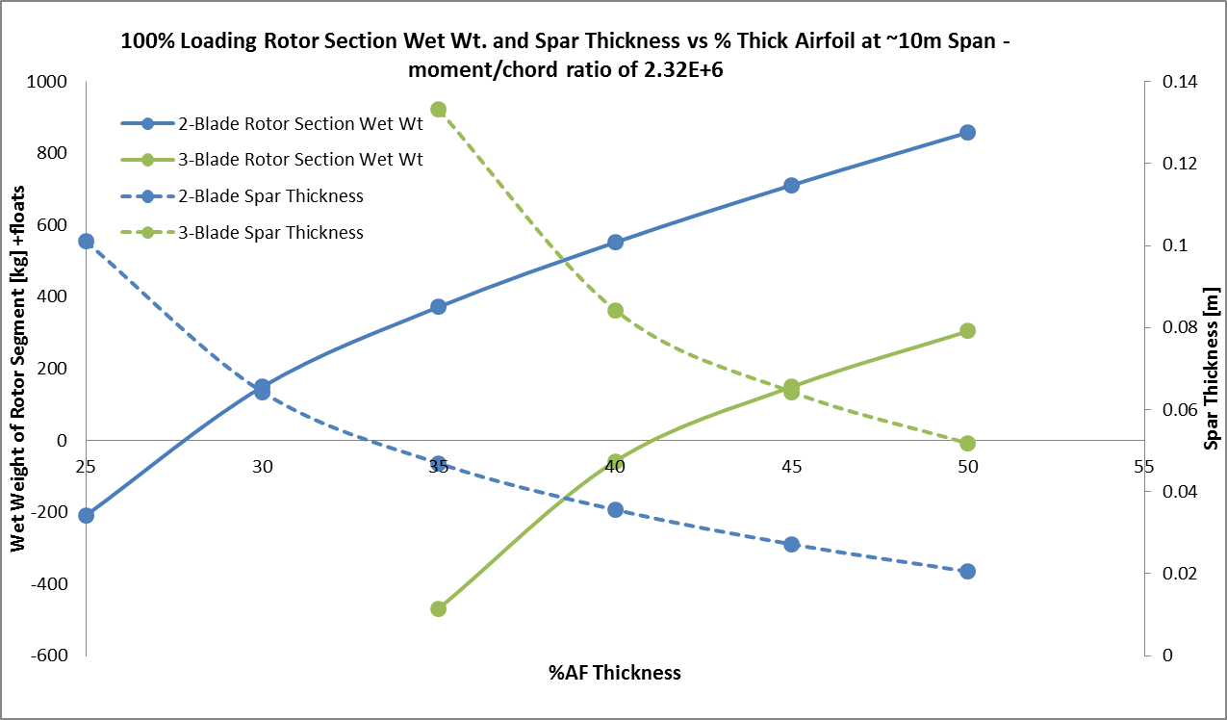
Preliminary Results – Effect of T/C
  % Thickness at given chord and moment vs. rotor section wet weight and spar thickness
  Two blade rotor is more buoyant at all section thicknesses.
  Three bladed configuration will not be possible to build at foils below 35% T/C for given moment. Spars intersect which is consistent with FEA results of 3-bladed rotor (25% thick foil)

Slide 6
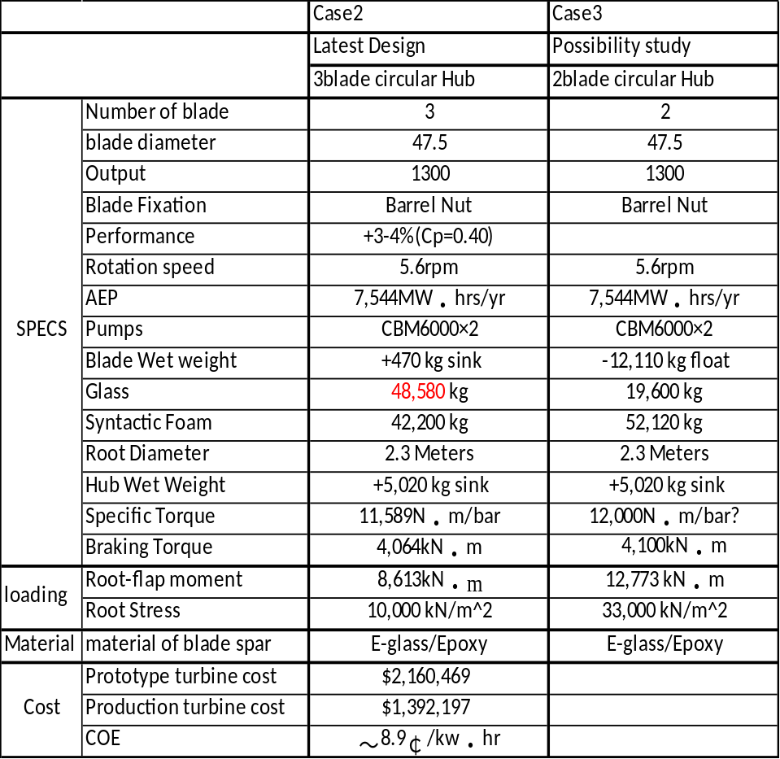
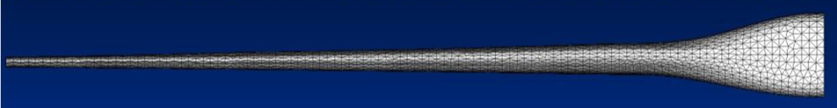
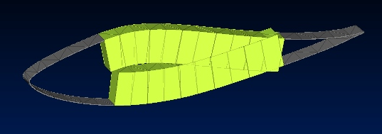
Preliminary Results – Effect of T/C cont.
  Three bladed config. will not be possible to build at foils below 35% T/C for given moment as spars intersect
  Preliminary FEA showed extremely heavy blade for 3-bladed configuration.
  10m span blade has 25% thick airfoil.

Slide 7
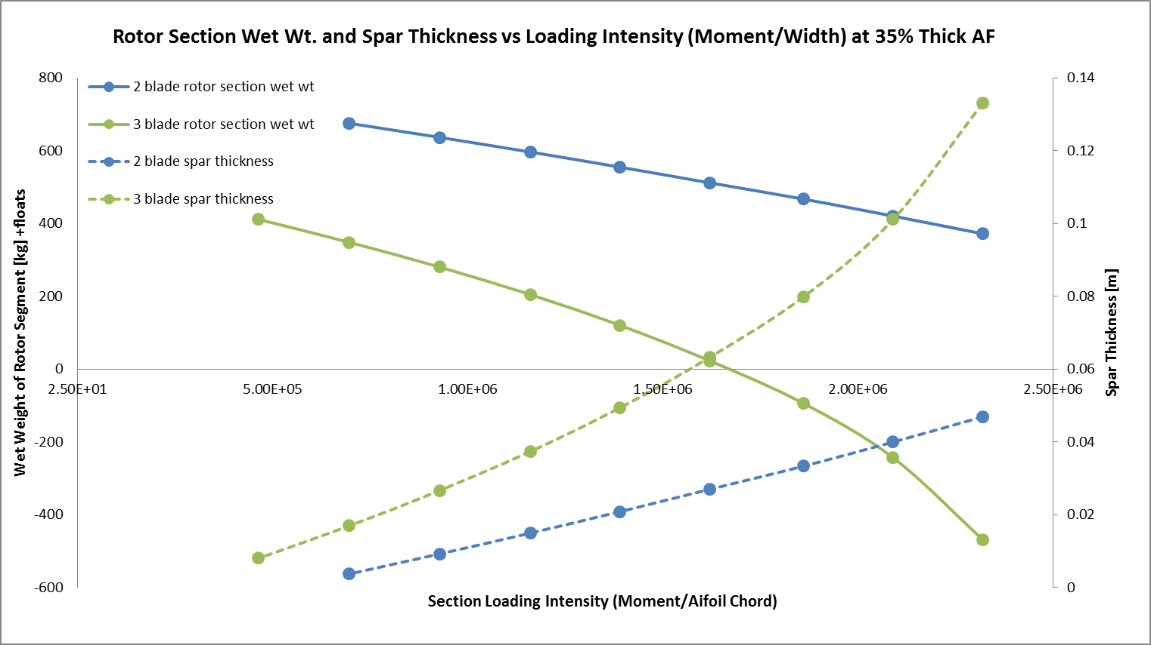
Preliminary Results – Effect of Loading Intensity
  Loading intensity at given 35% t/c vs. rotor section wet weight and spar thickness
  To evaluate effect on loading intensity, a constant 35% T/C was assumed and the assumed moment was reduced incrementally.
  Two bladed rotor is more buoyant at all loading intensities
  At very low moments, the model does not converge since all of the load is carried by the foam alone.

Slide 8
Take-Away & Next Steps
  For the given assumptions, a two-bladed rotor is more buoyant in all conditions investigated.
  Next Steps:
  Evaluate impact of sectional cost along with wet weight
  Cross-check hydrodynamic assumptions and their effect on system efficiency/power production.
  Check stress on foam. Assumed to be non-issue since modulus is dominated by spar.
  Expand model to include more accurate section calculator and be able to include multiple sections to begin thickness optimization studies

Slide 9
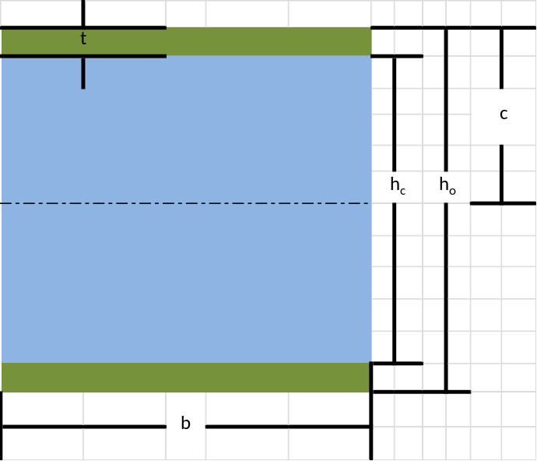

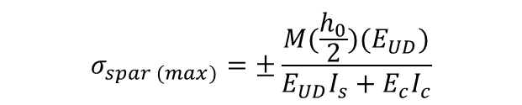

Calculation Assumptions
C | Chord | [m] | 2.35
b | Spar Cap Width | [m] | 1.41
M | Moment | [n-m] | 5.45E+06
E_{UD} | Modulus of Sparcap | [Pa] | 3.98E+10
E_{C} | Modulus of Core | [Pa] | 3.79E+09
σ_{s(max)} | Max Stress in Sparcap | [Pa] | 1.15E+08
L | Section Length | [m] | 1
ρ_{s} | Density of sparcap | [kg/m³] | 1920
ρ_{c} | Density of core | [kg/m³] | 673
ρ_{w} | Density of Seawater | [kg/m³] | 1029
ϵ_{UD(max)} | Max allow design strain UD | [-] | 2.90E-03
σs(allow) | Allowable stress in UD | [Pa] | 1.15E+08
 | Moment/Chord Ratio |  | 2.32E+06
$$I_{spar}=\frac{b}{12}({h_{o}}^{3}−{h_{c}}^{3})$$
$$I_{core}=\frac{b}{12}({h_{c}}^{3})$$
$$σ_{spar (max)}=±\frac{M(\frac{h_{0}}{2})(E_{UD})}{E_{UD}I_{s}+E_{c}I_{c}}$$
$$σ_{spar (allow)}=E_{UD}∈_{design}$$

Slide 10
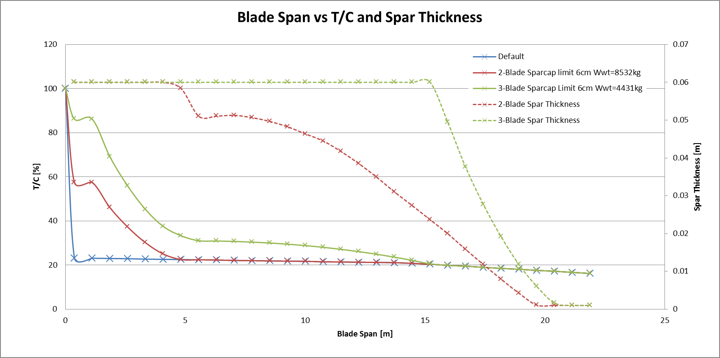
Blade Element Calculation

